Slide 1





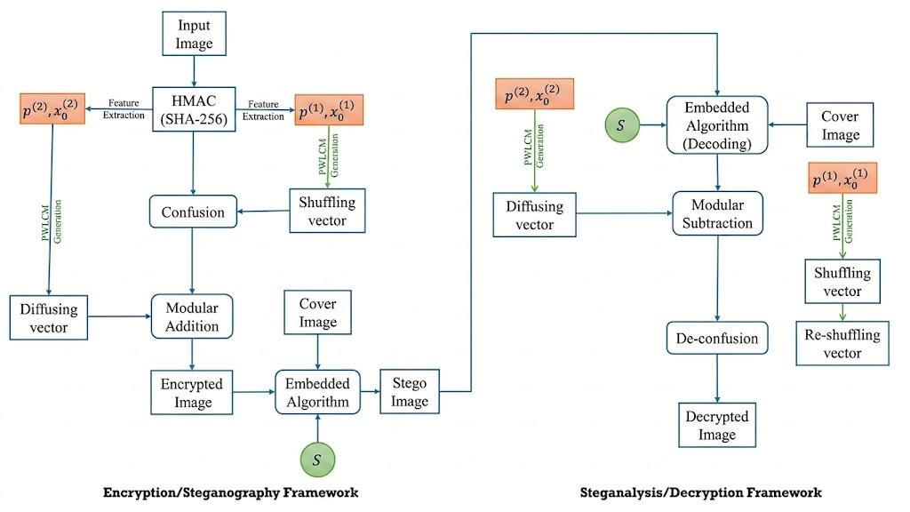
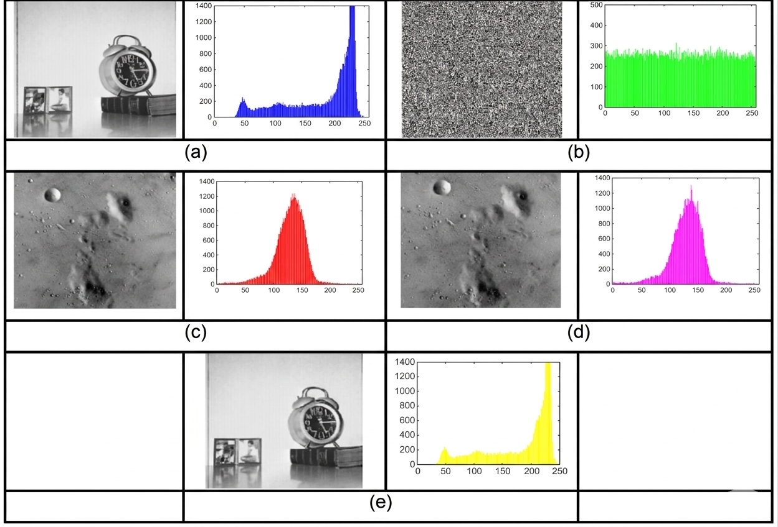
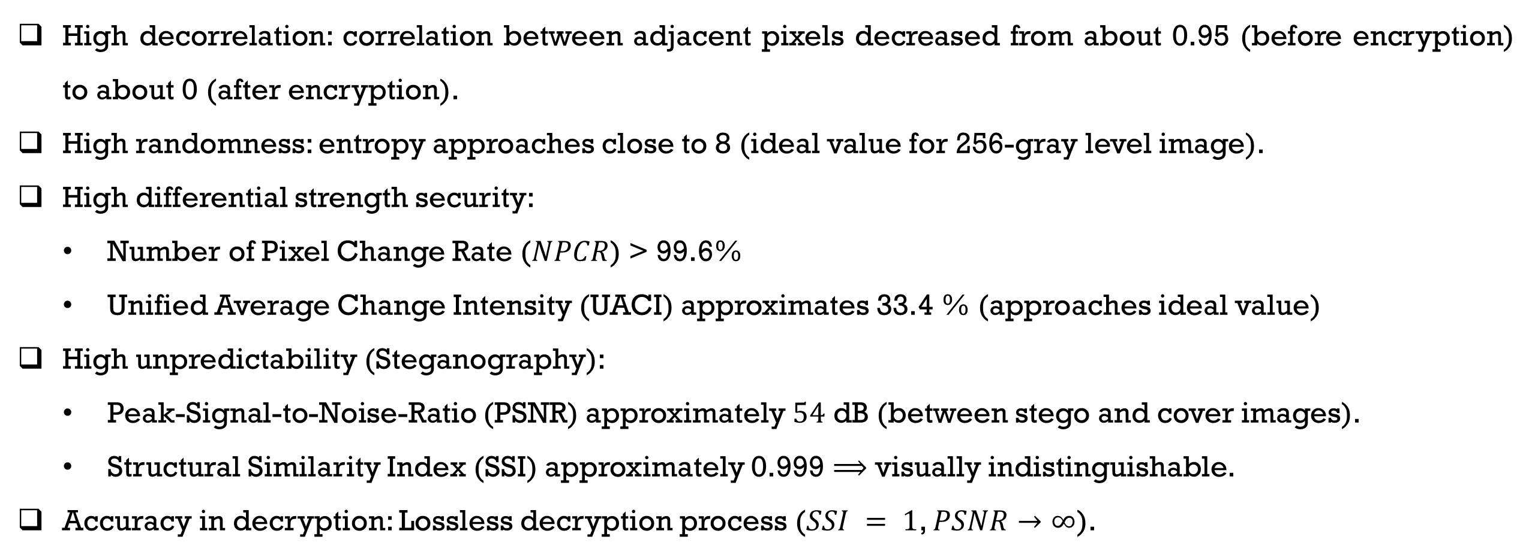
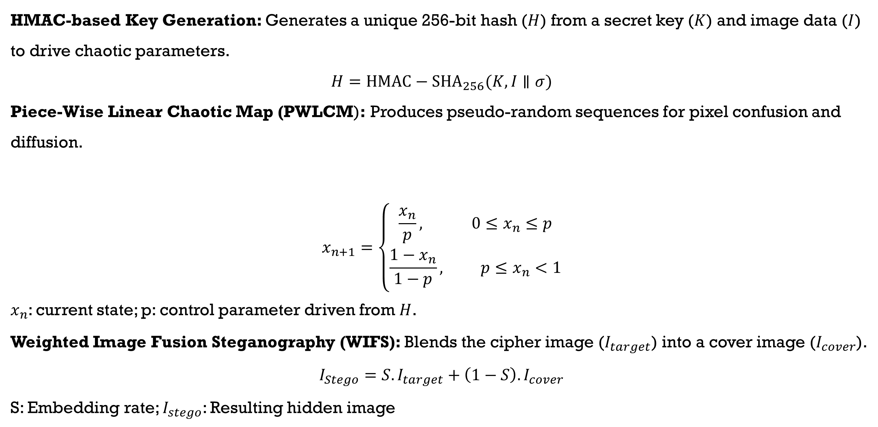
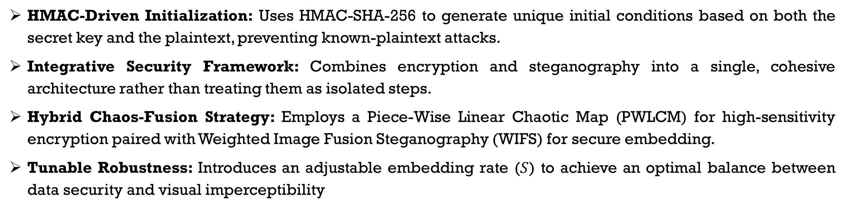
HMAC-Driven Chaotic Image Encryption for Robust Multimedia Security M. Karmany^{a,b}, A. Moawad^{c}, M. Abaza^{d}, A. Alfalouª, and A. Mansour^{b} ªLabISEN, LSL, ISEN Ouest, 29200 Brest, France
^{b}Lab-STICC, UMR 6285 CNRS, ENSTA Institut Polytechnique de Paris, Brest, France
^{c}ECE Department, Arab Academy for Science, Technology and Maritime Transport, Cairo 11769, Egypt
^{d}ECE Department, Arab Academy for Science, Technology and Maritime Transport, Giza 2033, Egypt
INTRODUCTION
Key Equations
Rapid multimedia transmission through public networks leads to more security threats.
Conventional techniques (Advanced Encryption Standards (AES), Rivest-Shamir-Adleman (RSA)) provides:
Strong security but insufficient in image data.
Less effective due to large redundancy and correlation between pixels.
Chaotic Encryption:
Offers high sensitivity to initial conditions.
Utilizes efficient, pseudo-random techniques specifically designed for images.
Steganography:
Enables secret communication by hiding data within carrier images.
Main problem:
Current approaches consider encryption and steganography as separate techniques.
Difficult to achieve security and imperceptibility.
Proposed solution: Integrative framework involving:
Hash Message Authentication code-based chaotic Encryption.
Weighted Image Fusion Steganography (WIFS).
Goal:
Achieve secure, robust, and visually imperceptible multimedia transmission.
HMAC-based Key Generation: Generates a unique 256-bit hash ($H$) from a secret key ($K$) and image data ($I$) to drive chaotic parameters.
$$H={HMAC−SHA}_{256}(K, I∥σ)$$
Piece-Wise Linear Chaotic Map (PWLCM): Produces pseudo-random sequences for pixel confusion and diffusion.
$$x_{n+1}=\left\{\begin{aligned}\frac{x_{n}}{p}, 0≤x_{n}≤p \\ \frac{1−x_{n}}{1−p}, p≤x_{n}<1\end{aligned}\right.$$
$x_{n}$: current state; p: control parameter driven from $H$.
Weighted Image Fusion Steganography (WIFS): Blends the cipher image ($I_{target}$) into a cover image ($I_{cover}$).
$I_{Stego}=S.I_{target}+\left(1−S\right).I_{cover}$
S: Embedding rate; $I_{stego}$: Resulting hidden image
Figure 1: represents the overall scheme of the proposed method involves the use of Hash-based Message Authentication code (HMAC) based key generation, chaotic encryption, and steganography to transmit and receive images safely
Figure 2: Integrative Encryption and Steganography Framework. The plaintext image is transformed into a high-entropy cipher with a uniform histogram through HMAC-driven chaotic encryption. This cipher is embedded into a cover image using WIFS to generate a visually imperceptible stego-image, followed by high-fidelity decryption for lossless recovery.
Key contributions
RESULTS
HMAC-Driven Initialization: Uses HMAC-SHA-256 to generate unique initial conditions based on both the secret key and the plaintext, preventing known-plaintext attacks.
Integrative Security Framework: Combines encryption and steganography into a single, cohesive architecture rather than treating them as isolated steps.
Hybrid Chaos-Fusion Strategy: Employs a Piece-Wise Linear Chaotic Map (PWLCM) for high-sensitivity encryption paired with Weighted Image Fusion Steganography (WIFS) for secure embedding.
Tunable Robustness: Introduces an adjustable embedding rate ($S$) to achieve an optimal balance between data security and visual imperceptibility
High decorrelation: correlation between adjacent pixels decreased from about 0.95 (before encryption) to about 0 (after encryption).
High randomness: entropy approaches close to 8 (ideal value for 256-gray level image).
High differential strength security:
Number of Pixel Change Rate ($NPCR$) > 99.6%
Unified Average Change Intensity (UACI) approximates 33.4 % (approaches ideal value)
High unpredictability (Steganography):
Peak-Signal-to-Noise-Ratio (PSNR) approximately $54$ dB (between stego and cover images).
Structural Similarity Index (SSI) approximately 0.999 $⟹$ visually indistinguishable.
Accuracy in decryption: Lossless decryption process ($SSI = 1$, $PSNR→∞$).
KEY Model / Mathematical Model
Generation of keys based on Hash-based Message Authentication Code-Secure Hash Algorithm (HMAC-SHA-256) to ensure high dependency of the result on both the secret key and the plaintext.
Keys serve as initial conditions in a PWLCM for the generation of pseudo-random sequences.
Chaos-based sequences are employed for:
Confusion: pixel permutation to destroy spatial. correlation.
Diffusion: pixel value manipulation for increased security.
The resulting cipher image is concealed into the cover image utilizing Weighted Image Fusion Steganography (WIFS).
With WIFS, the embedding rate can be adjusted to obtain both unpredictability and robustness.
Ensures secure and reliable multimedia communications
conclusion
Our proposed technique is an integration of HMAC-SHA-256, PWLM chaotic encryption, and WIFS steganography.
Our results demonstrates high security with resistance against attacks based on statistics and differentials.
It ensures high imperceptibility and accurate (lossless) image recovery.
For further information or inquiries, please feel free to contact: Mahmoud.karmany@isen-ouest.yncrea.fr mahmod.karmany@ensta.fr

